Slide 1
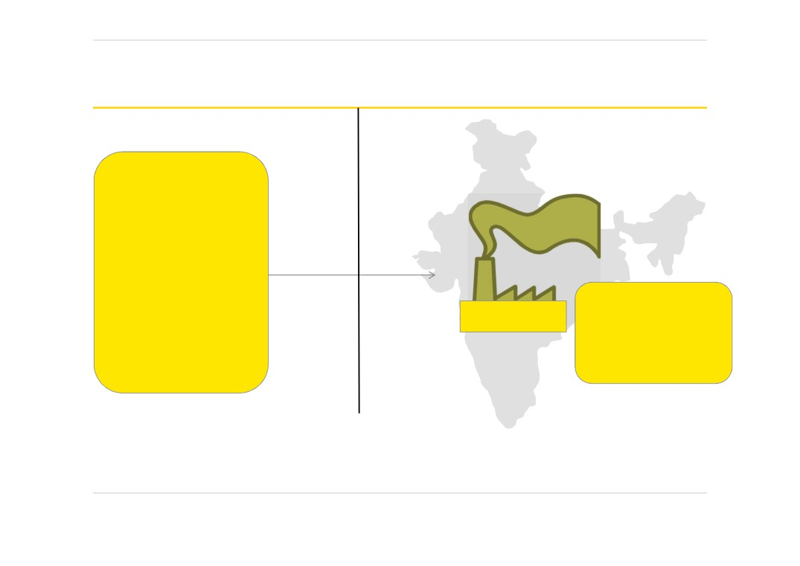
Calcutta Jute Mills Co v Nicholsan (1 TC 83) 1876
UK
India
§ CJM incorporated in UK
§ CJM did not own any office / operation in
UK
§ 5 - UK directors and 1
director in India
UK company carried on the trade of jute
§ Board meetings, and AGM held in London
Calcutta Jute Mill Co. (‘CJM’)
spinners and
in an office lent by a director
manufacturers in Calcutta, India.
► UK Court held absence of office premises in UK was an irrelevant factor in deciding the corporate tax residence.
► Company undoubtedly resides at the office or place where the directors meet- meetings of the whole company are held and where they transact their business and exercise the powers conferred upon them by the law and AoA.
Slide 1
POEM Discussion

Slide 2
Cesena Sulphur Company v Nicholsan (1 TC 88) 1876
United Kingdom
Italy
County of Incorporation
Country of registration
No sale
Mining and sale of Sulphur
Meeting of BOD and shareholders
Majority
shareholders
Italian
residents
Declaration of dividend and determining the MD lived in Italy future of business
Findings of UK Court
Company for tax purpose is Resident:
► Where every act connected with the administrative part of business was done; ► The place from where all the orders came, all the directions flowed; ► Where the appointments of the various officers were made and revoked, ► Where agents were nominated and recalled,
► Where the money was received and dividends were declared and were payable.
We find all these acts performed in London… thus
resident of UK
Page 2
POEM Discussion

Slide 3
De Beers Consolidated Mines Ltd v Howe (5 TC 198) 1905
Particulars
London
Kimberley
Country of Incorporation - owned mines and mining
-
√
property
Ordinary directors
9
7
Life Governors
2
1
Meetings held weekly
√
√
Powers of BOD in London
Powers of BOD in Kimberley
· Negotiation of the contracts with the Diamond Syndicates · Advise directors in Kimberley on matters of exceptional importance · Policy in respect of disposal of diamonds and other assets · Policy in respect of working and development of mines and output of
· Determine the
course of
business in respect of mining diamonds
diamonds
· Policy in respect of application of profits and appointment of directors · Appointment of directors
· BOD meetings to arrive at absolute majority for decision-making purposes
Page 3
POEM Discussion

Slide 4
De Beers Consolidated Mines Ltd v Howe (5 TC 198) 1905
Place where board of directors
meetings are held
Place where chief seat of management is located
Central management and
Control test laid down which became rule of law
Place where actual decision making
Place where head and brain of the
by majority of directors take place
company is located
“A company cannot eat or sleep, but it can keep house and do business. We ought, therefore, to see where it really keeps house and does business.’
“The decision of Kelly C.B. and Huddleston B. in the Calcutta Jute Mills v. Nicholson and the Cesena Sulphur Co. v. Nicholson, now thirty years ago, involved the principle that a company resides for purposes of income tax where its real business is carried on. I regard that as the true rule, and the real business is carried on where the central management and control actually abides”
Page 4
POEM Discussion

Slide 5
Smallwood v Revenue & Customs (SpcC 669) (2008)
CM&C differed from POEM, in part due to the fact that the former was a ‘one residence test ‘, while the letter would be applies as a ‘dual residence test’.
“Effective” in POEM should be understood in the sense of French effective which connotes real [French is another official version of OECD model]
First in time in Wensleydale's Settlement Trustees ‘ case in which Special Commissioner David Shirley said of POEM to mean:

Slide 6
Smallwood v Revenue & Customs (SpcC 669) (2008)
"I emphasise the adjective 'effective'. In my opinion it is not sufficient that some sort of management was carried on in the Republic of Ireland such as operating a bank account in the name of the trustees. 'Effective‘ implies realistic, positive management. The place of effective management is where the shots are called, to adopt a vivid transatlantic colloquialism.“
Also warned about adopting alternative paraphrases such as "calling the shots" because in a way shareholders called the shots but this was not a relevant type of control. However, we adopt his reference to "realistic, positive management."

Slide 7
Key principles emerging from other decisions – relevant for subsidiaries.
Bullock v Unit Construction Company (38 TC 738)
While certain operational decisions have been made at a subsidiary level, the directors of the UK parent company had always made key decisions in respect of the three subsidiaries.
It was thus held that the subsidiaries were UK residents.
Egyptian Delta Land & Investment co. ltd v Todd (14 TC 119)
If a company has no place of trade in the UK and does nothing at its head office except for minimum and occasional formalities, it cannot be a resident there. The company therefore held to be resident in Egypt. Court emphasised that the place of incorporation alone would be inadequate to conclude on the residency of a taxpayer.
American Thread company v Joyce (6 TC 1/163)
Control of the management of the affairs of the American Company vested in UK given that strategic decisions were made at a UK level and that the American Company’s board was constantly dominated by the English Company.
Page 7

Slide 8
POEM – International judicial precedents
Case
Held
Hoge raad der netherlands
(Netherlands SC)
The term “effective management” is related to taking core decisions, directing, and taking initiatives, rather than carrying out, or preparing or determining, policy, or determining the company's activities.
As daily management seems in opposition to key management, it is unlikely that it could ever make up part of any core decisions.
Case 2C 1086/2012,2C 1087/2012
(Switzerland SC)
POEM must be distinguished from both top-level management activities and purely administrative activities.
POEM defines as the economic and effective center of a company.
Yanko weis Holdings Ltd v. Holon income tax Assessor
(Israel district court)
POEM should be determined on the basis of a factual assessment of where the decisions as to the company's business policies, strategy and daily decisions were taken
Place where the management decisions were actually taken instead of execution the same.
The decisive factor is the management of daily business activities within the company's purpose.
Page 6

Slide 9
UK HMRC Position- INTM120210
It may be exceptional for the directors of a company to stand aside completely. It is, however, not unusual for directors to act in accordance with the wishes of the parent. We took advice about the matter and the advice was that the test should properly be whether the local directors apply their minds to `suggestions' from the parent and form an independent judgment before implementing their parent's wishes or whether, on the other hand, they merely `rubber stamp' and carry out without serious question the higher policy wishes of the parent company.
Notes:
No definition for company residence in law
Based on court made law on C & M test
Incorporation test included in 1988
Board Vs Members powers – Members cannot usurp BOD

Slide 10
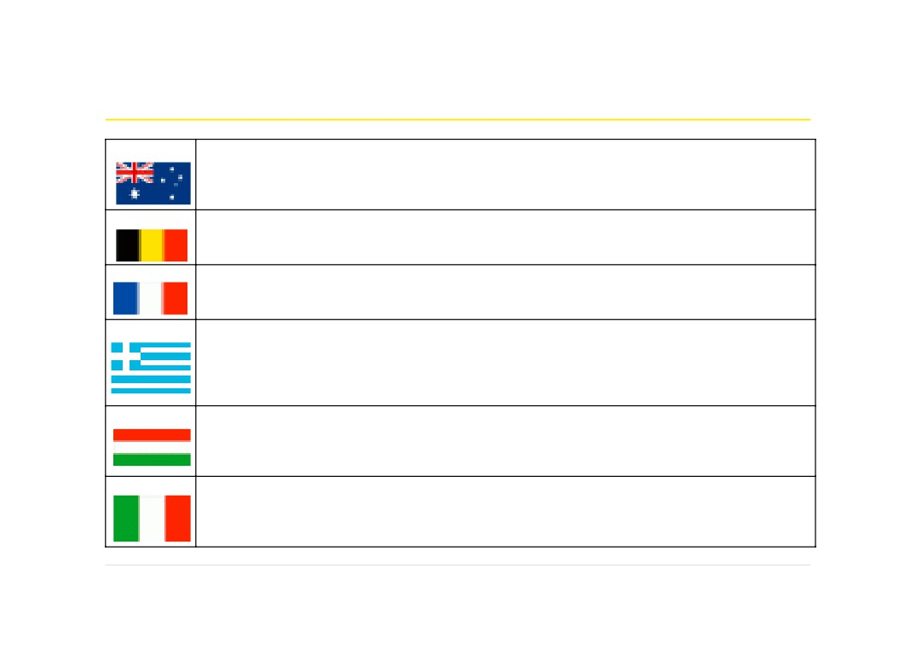
Residency Rules - interpretation of POEM
Australia
A company becomes a resident of Australia if it is incorporated in Australia or if it carries on
business in Australia, and has either its central management and control in Australia or its voting power is controlled by shareholders who are residents of Australia
Belgium
Belgian tax law defines POEM as the place where the actual key decisions controlling the company
are taken, disregarding the location where the BOD formally approve decisions taken elsewhere
France
France has interpreted the OECD commentary for the determination of POEM as place where the
person or the group of persons exercising the most senior functions makes its decision
Greece
POEM is the place where the day-to-day management of the company takes place, where the
strategic business decisions are made, where the key meetings take place, where the accounting books are kept or if the BOD comprises of Greek residents. The tax administration may also examine additional factors
Hungary
POEM is the place where the key management and commercial decisions are made, where the top
executives are located and where the senior executives carry on day to day management of the enterprise
Italy Italian tax laws determine POEM as the place where the main and substantial activity of the entity
is carried on. However, the courts consider POEM as the place where key decisions are actually taken, irrespective of the place where they are formally made
Page 7 POEM Discussion

Slide 11
Residency Rules - interpretation of POEM
Netherlands
Domestic tax law considers POM where the place of ultimate managerial responsibilities over the
place where day-to-day management is effected
Russia A foreign company is deemed to be a resident in Russia if a relative majority of board meetings
are held in Russia, if executive body regularly conducts company related activities from Russia or if the Chief executives perform their managerial duties from Russia. Tax administrations may consider other criteria such as place of maintenance of accounting records, place from which HR functions are undertaken, etc
USA US follows the OECD commentary for the determination of POEM. However, it reserves the right
to use a place of incorporation test for the determination of tax residency of a corporation
Each contracting state adopts different criteria for
determining the POEM
Page 8
POEM Discussion

