Slide 1
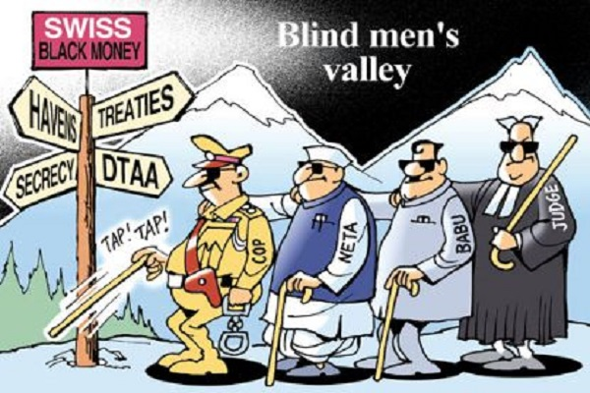
International Fiscal Association (IFA)
Eastern Region Chapter
The Black Money (Undisclosed Foreign Income and Assets) and Imposition of Tax Act, 2015
T. P. OSTWAL

Slide 2
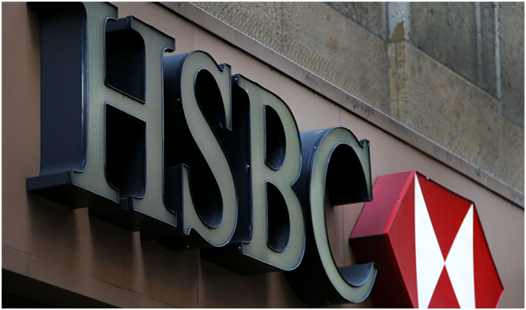
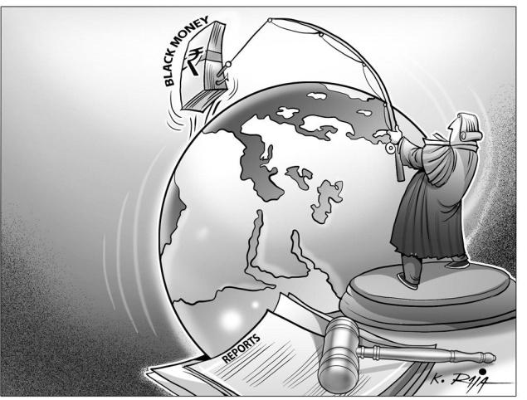
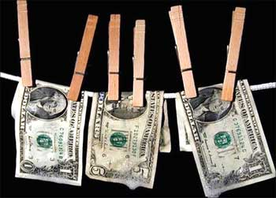
INTRODUCTION
The Black Money (Undisclosed Foreign Income and Assets) and Imposition of Tax Act, 2015 is applicable from 1 April 2016 i.e. from A Y 2016-17.
Bringing tax evasion under the net of Prevention of Money Laundering Act, 2002.
Supreme Court directives and Special Investigation Team (SIT) findings
Focus on undisclosed income and assets outside India.
Need for stringent laws to curb tax evasion.
Swiss Bank disclosures on bank accounts owned by Indians and media reports
Information received from countries like France, Germany, etc.

Slide 3
EU, Swiss Sign Agreement To End Bank Secrecy
The European Commission and the Swiss government May 27 signed a landmark new tax transparency agreement, which will effectively end bank secrecy for Europeans, strengthen the fight against tax evasion and prevent tax evaders from hiding undeclared income in Swiss accounts.

Slide 4
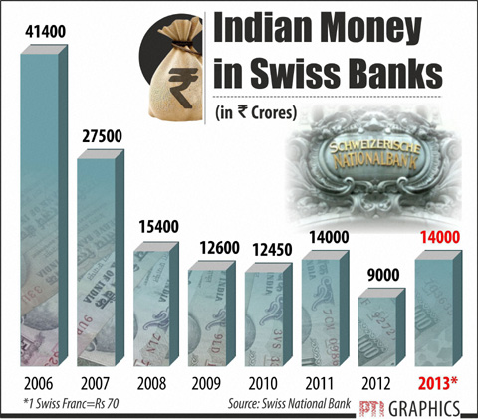
BLACK MONEY PROBE
India signs the Multilateral Competent Authority Agreement (MCAA) pact on Automatic Exchange of Information (AEOI)
- Previously, 54 countries had joined the MCAA.
- India is among six countries that joined this taking the number to 60.
- The target is to reach 94 countries by 2017.
Recently Switzerland’s Official Gazette revealed publicly names of seven Indians on the list for tax evasion
Swiss Federal Tax Administration has asked to file an appeal within 30 days if they do not want their details to be shared with the Indian authorities.
The names of the seven persons are
- Yash Birla,
- Gurjit Singh Kochar,
- Ritika Sharma, Sneh Lata Sawhney and Sangita Sawhney,
- Sayed Mohamed Masood and his wife Chaud Kauser Mohamed Masood
Notes:
The new system, dubbed the Common Reporting Standards (CRS) on Automatic Exchange of Information, is very wide in scope and obliges the treaty partners to exchange a wide range of financial information, including that about the ultimate controlling persons and beneficial owners of entities.
To be able to comply with the new system, amendments have been made to section 285BA of the Income Tax Act, 1961. Necessary rules and guidelines are being formulated in consultation with financial institutions.
Previously, information was exchanged between countries on the basis of specific requests relating to cases of tax evasion and other financial crimes.
AEOI, when fully implemented, sets up a system wherein bulk taxpayer information will periodically be sent by the source country of income to the country of residence of the taxpayer.

Slide 5
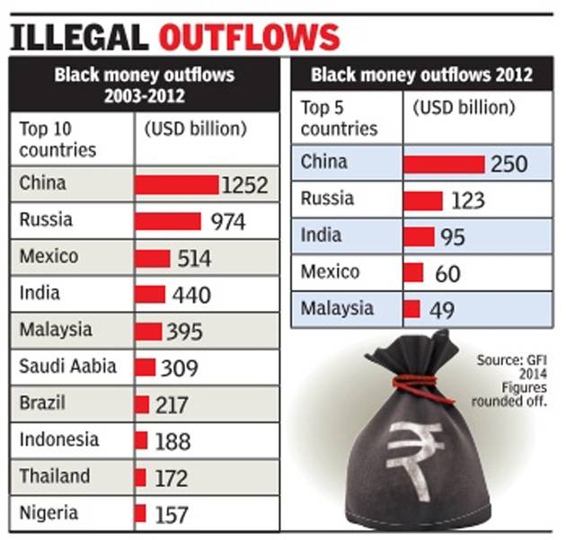
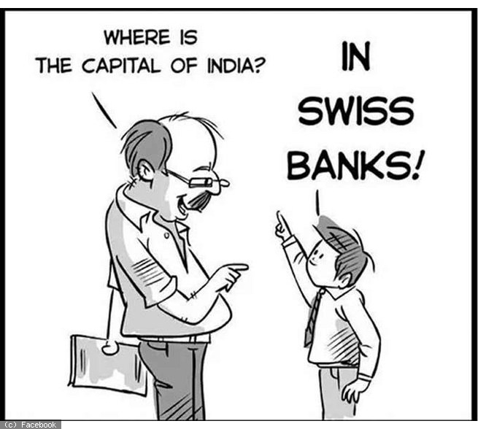
BLACK MONEY PROBE
A list of 628 names was submitted in 2010 by France to India. There are people who allegedly held bank accounts at HSBC's Geneva branch.
India has so far initiated action in 121 cases. No activity or money deposits have been found in 202 accounts.
Late last year, Mr Jaitley said 250 Indians on the HSBC list had admitted to holding foreign accounts but cautioned that not all of them were illicit.

Slide 6
Preliminary
Basis of charge
Tax Management
Penalties
Offences and Prosecution
Onetime disclosure window
General Provisions
Structure of the Black Money Act
Black Money act has 88 sections and
7 chapters as under:

Slide 7
SCOPE
Black Money Act applies to all persons who are ‘resident and ordinarily resident’ in India.
“Undisclosed asset located outside India” means an asset (including financial interest in any entity) located outside India:
“Undisclosed foreign income and asset” means the total amount of undisclosed income of an assessee from a source located outside India and the value of an undisclosed asset located outside India.
the explanation given by him is in the opinion of the assessing officer unsatisfactory.
he has no explanation about the source of investment in such asset; OR
held by the assessee in his name or where he is a ‘beneficial owner’; AND

Slide 8
WHO IS ASSESSEE?
Section 2(1) defines “Assessee” as under:
“assessee” means a person, being a resident other than not ordinarily resident in India within the meaning of clause (6) of section 6 of the Income-tax Act, by whom tax in respect of undisclosed foreign income and assets, or any other sum of money, is payable under this Act and includes every person who is deemed to be an assessee in default under this Act”
The term ‘person’ is not defined in the Black Money Act so its definition under the ITA must be adopted. Accordingly, assessee will include individual, HUF, company, firm, AOP, BOI, local authority and every artificial judicial person.
This Act will not apply to any person who is Not Ordinary Resident and Non Resident.

Slide 9
IMPORTANT DEFINITIONS
SAME AS INCOME TAX ACT
TERM/WORDS | UFIA | I.T. ACT
Appellate Tribunal | 2(1) | 2(4)
Assessment | 2(3) | 2(8)
Assessment Year | 2(4) | 2(9)
Board | 2(5) | 2(12)
Resident | 2(10) | 2(42)
u/s. 2(15) UFIA
- all other words and expressions used herein but not defined and defined in the Income-tax Act shall have the meanings respectively assigned to them in that Act.

Slide 10
APPLICABILITY OF THE BLACK MONEY Act FOR INDIVIDUALS
 | Resident & Ordinary Resident (ROR) | Resident but Not Ordinary Resident (RNOR) | Non Resident
Whether resident in previous year? | Yes | Yes | No
Whether satisfies conditions prescribed u/s 6 of ITA? | Yes | No | No
Whether Black Money Act is attracted? | Yes | No | No
What would be the consequence where a person is resident more than one Country (Dual Residence Cases)?

Slide 11
IMPACT OF POEM ON CERTAIN COMPANIES
(AMENDMENT IN SEC. 6 OF THE ITA BY FINANCE ACT, 2015)
Hitherto, the test of residency was whether the company is incorporated in India or is wholly controlled and managed within India.
Replaced term “wholly controlled and managed within India” with the standard of “place of effective management” (POEM).
POEM has been defined to mean “a place where key management and commercial decisions that are necessary for the conduct of the business of an entity as a whole are, in substance made”
A foreign company will be considered tax resident in India if its POEM is in India in the relevant financial year..
Since POEM has become the test for corporate residence in the ITA in India, the impact of the Black Money Act will have a wider scope than intended.

Slide 12
WHAT IS UNDISCLOSED ASSETS Located Outside India ?
As per section 2(11), Undisclosed Assets located Outside India (including Financial Interest in any entity) means:
Assets held by the assessee in his own name
OR
in respect of which assessee is a beneficial owner and he has no explanation about the source of investment in such assets or explanation given by him is in the opinion of the Assessing Officer is unsatisfactory.
Section 2(12) defines “Undisclosed Foreign Income and Assets “means:-
Income of an assessee from a sources located outside India and the value of an undisclosed asset located outside India, computed as per section 5 and as referred to in section 4.
Notes:
A clue can be taken from the Instructions to the Income Tax Returns: “Financial interest would include, but would not be limited to, any of the following:-(1) if the resident assessee is the owner of record or holder of legal title of any financial account, irrespective of whether he is the beneficiary or not.
(2) if the owner of record or holder of title is one of the following:- (i) an agent, nominee, attorney or a person acting in some other capacity on behalf of the resident assessee with respect to the entity. (ii) a corporation in which the resident owns, directly or indirectly, any share or voting power.
(iii) a partnership in which the resident assessee owns, directly or indirectly, an interest in partnership profits or an interest in partnership capital.
(iv) a trust of which the resident has beneficial or ownership interest.
(v) any other entity in which the resident owns, directly or indirectly, any voting power or equity interest or assets or interest in profits.”

Slide 13
What is Financial Interest in any entity?

Slide 14
An undefined term under ITA & UFIA

Slide 15
Refer to the Instructions in the form of Return of Income: “Financial interest would include, but would not be limited to, any of the following:-
(1) if the resident assessee is the owner of record or holder of legal title of any financial account, irrespective of whether he is the beneficiary or not.
(2) if the owner of record or holder of title is one of the following:-
(i) an agent, nominee, attorney or a person acting in some other capacity on behalf of the resident assessee with respect to the entity. (ii) a corporation in which the resident owns, directly or indirectly, any share or voting power.
(iii) a partnership in which the resident assessee owns, directly or indirectly, an interest in partnership profits or an interest in partnership capital.
(iv) a trust of which the resident has beneficial or ownership interest.
(v) any other entity in which the resident owns, directly or indirectly, any voting power or equity interest or assets or interest in profits.”

Slide 16
SECTION 3- BASIS OF CHARGE
The charge is for every assessment & hence this Act is permanent feature of our tax system & will act as a deterrence to accumulate income or assets abroad.
Tax on Undisclosed Income and Assets is @ 30% & charged to tax in the previous year in which it has come to the notice of the assessing officer.
No Surcharge and Education Cess on Tax or Penalty.
Value of Assets shall be taken at “Fair Market Value” determined as per Rules in the previous year in which such asset comes to the notice of Assessing Officer.
Exodus of people from India started (as it does not apply to Non Residents).

Slide 17
Scope of Total Undisclosed Foreign Income and Asset (S.4)
The Act will apply from FY 2015-16 (AY 2016-17).
Scope will cover –
Income in respect of which no return is filed within time allowed u/s 139(1), 139(4) & 139(5) of the ITA.
Value of an undisclosed asset located outside India
Any variation made in the income from a source outside India in the Assessment or Reassessment of the total income of any previous year, in accordance with section 29 to 43C (Business Income), 57 to 59 (Income from Other Sources) or 92C of the ITA shall not be considered as Undisclosed Income.
Note: Income from House Property and Capital Gains excluded from above
No clarification for adjustment made u/s 93 or 94A or Exchange Rate Differences.
Deemed Income of foreign property u/s 23 of the ITA?

Slide 18
Section 5 - Computation Mechanism
No deduction of expenses and setoff of any losses.
Means taxed on Gross Basis.
No deduction for liability in relation to any foreign assets purchased.
If assessee furnishes evidence that any income which is assessable or assessed to tax in any previous year prior to 01.04.2015, shall not be added.

Slide 19
Computation of tax on UFIA
Computation of total UFIA
Income from source located outside India (foreign income or ‘ FI’ ) which has not been disclosed in IT Return | XX
FI in respect of which no IT return has been filed | XX
FMV of UFA (no explanation or unsatisfactory explanation about the source of income has been provided ) –manner of valuation to be provided | XX
Less
Income which has been assessed to tax for any assessment year under the ITA prior to relevant AY in which UFIA applies | XX
Income which is assessable or has been assessed to tax for any assessment year | XX
In case of immovable properties, the deduction will be: Value of UFA in the same proportion as assessed / assessable foreign income bears total cost | XX
Total value of UFIA | XX
Tax @ 30% | XX
The quantum of penalty may vary between 100% to 300% of the tax amount, depending on whether voluntarily disclosures are made under one time disclosure window or UFIA is detected by Assessing officer

Slide 20
Computation of tax on UFIA
Illustration:
•Mr. A acquired foreign asset (immovable property) in the AY 2010-11 for Rs.60 lacs. Out of the total investment, Rs.40 lacs was assessed to tax in an earlier year.
•In AY 17-18, AO identified the value of such undisclosed asset as Rs.2 crore for which no explanation was provided
Computation of total UFIA | Rs. (in crores)
FMV of UFA (no explanation provided or explanation not satisfactory) | 2.00
Less
Income which has been assessed to tax for any assessment year under the ITA prior to relevant AY in which the Black Money Act [Rs.2crore -(Rs.2crore X 0.40 lacs / 0.60lacs)] | (1.33)
Amount chargeable to tax under Black Money Act | 0.67

Slide 21
No requirement to file a separate return under Black Money Act.
The assessing officer on receipt of information from Income Tax Authority under the ITA or any other authority under any law or on coming of any information to his notice (source of information not specified) shall serve a notice requiring assessee to produce such information and document as he may require.
E.g: Information may be from sources such as legal or illegal or stolen data.
Issue of notice for assessment/reassessment (no timeline provided), opportunity of being heard and furnishing of evidences/documents will be given –principles of natural justice to be followed
Inquiry or investigation by Tax Authorities into matters of the assessee even though there are no proceedings pending before it
Tax Management – Assessment Procedure (Chapter III)

Slide 22
Tax Management – Assessment Procedure (Chapter III) (CONTD)…
Time limit for completion of assessment and reassessment shall be 2years from the end of the financial year in which notice was issued
It is expected that two assessment orders will be passed in respect of period covered by a single return of income: under section 143(3) of ITA and 10(3) of Black Money Act
Remedial measures provided-appeal to CIT(A)/ITAT/High Court and Supreme Court (for substantial question of law), rectification of mistakes, revision of orders, recovery of arrears

Slide 23
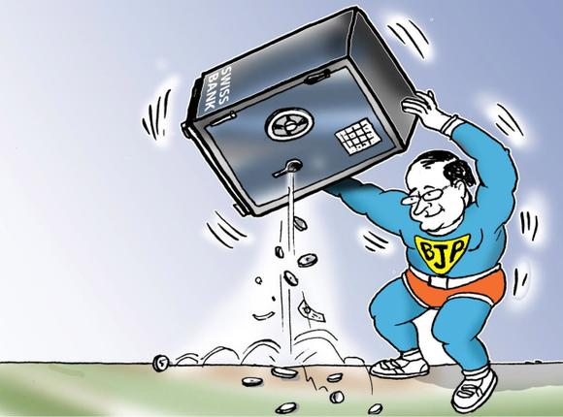
Recovery of Tax
Power of AO to recover the outstanding demand from the assessee as per any mode specified
AO or Tax Recovery Officer (TRO) may direct:
i) employer of the assessee to deduct tax in arrear from the assessee, from any amount payable to the assessee.
ii) debtor of the assessee to pay tax in arrear from the assessee, not exceeding the amount of debt.
If debtor fails to make payment, he shall be deemed to be assessee in default and proceedings may be initiated against him for realization of amount.
Section 31(6): Assessee cannot dispute the correctness of the any certificate drawn up by TRO on any ground whatsoever.

Slide 24
Liability on persons other than assessee
Section 35 and 36 :- Black Money Act imposes personal liability on
manager (including a managing director) of a company,
partners,
member of AOP or BOI
for any amount due, if the amount is not recoverable from the company/ firm/ AOP BOI.
Only manager of the company and partner of Limited Liability Partnership (LLP) will not be held liable
if he proves that non-recovery cannot be attributed to any neglect, misfeasance or breach of duty on his part in relation to the affairs of the company/ LLP.
The Act is silent on the liability of partners of the firm other than LLP and members of AOP and BOI.
The Black Money Act imposes liability on the person for abetting or inducing another to willfully attempt to evade tax or to make false statements/declarations in relation to foreign income and assets.

Slide 25
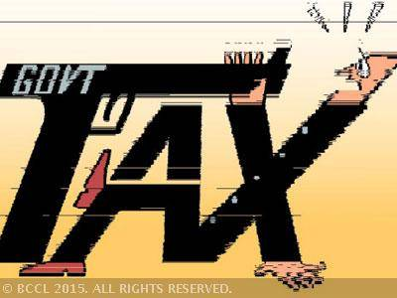
Chap IV - Penalty & Chap V – Offences & Prosecutions
Nature | Penalty | Prosecution (if any)
Attempt to evade tax, interest and penalty | 300% of the Tax Payable | 3 years – 10 years
Failure to disclose foreign asset or income in the return of income ** | Rs. 10 Lakh | 6 months – 7 years
Attempt to evade payment of tax, interest and penalty | Amount of Tax arrear | 3 months – 3 years
** Failure to report bank accounts with a maximum balance of upto Rs.5 lakh at any time during the year will not entail penalty or prosecution.
Notes:
Section 43 - If any person, being a resident other than not ordinarily resident in India within the meaning of clause (6) of section 6 of the Income-tax Act, who has furnished the return of income for any previous year under sub-section (1) or sub-section (4) or sub-section (5) of section 139 of the said Act, fails to furnish any information or furnishes inaccurate particulars in such return relating to any asset (including financial interest in any entity) located outside India, held by him as a beneficial owner or otherwise, or in respect of which he was a beneficiary, or relating to any income from a source located outside India, at any time during such previous year, the Assessing Officer may direct that such person shall pay, by way of penalty, a sum of ten lakh rupees:

Slide 26
Chap IV - Penalty & Chap V – Offences & Prosecutions
Nature | Penalty | Prosecution (if any)
Subsequent offences under this Act- where a person commits the second (or subsequent) offence |  | 3 years – 10 years Plus Fine Rs.5 lac to Rs.1 cr
Person makes false statement or delivers false evidences |  | 6 months – 7 years
Abetment to make and deliver false return, account, statement or declaration relating to tax payable |  | 6 months – 7 years
If assessee fails to answer any question, sign a statement he is legally bound to or fails to produce books and supporting evidences | Rs. 50,000 to Rs. 2,00,000

Slide 27
Section 54- Presumption as to Culpable Mental State
Section 54 reads as under:
(1) In any prosecution for any offence under this Act which requires a culpable mental state on the part of the accused, the court shall presume the existence of such mental state but it shall be a defence for the accused to prove the fact that he had no such mental state with respect to the act charged as an offence in that prosecution.
Explanation.—In this sub-section, “culpable mental state” includes intention, motive or knowledge of a fact or belief in, or reason to believe, a fact.
(2) For the purposes of this section, a fact is said to be proved only when the court believes it to exist beyond reasonable doubt and not merely when its existence is established by a preponderance of probability.
(Corresponds to Sec 278E of ITA)
Onus to prove non-culpability beyond reasonable doubt is shifted on the accused

Slide 28
One Time Compliance Procedure Chapter VI

Slide 29
One Time Compliance Procedure – Chapter VI
Positioned as not being an amnesty scheme –there is no immunity from penalty
One time compliance scheme window (with a time limit to be notified) for disclosing any UFA and acquired from income chargeable to tax under ITA for any assessment year prior to AY 2016-17
Finance Minister has indicated that a time limit of 2 months from the date of President's assent for one time compliance and 6 months for payment of tax and penalty –Source Press Trust of India (PTI)
Merely an opportunity for persons to come clean and become compliant before the stringent provisions of the new Act come into force
Any person can make declaration (format and the due date to be notified) in respect of UFAs and pay tax on it @ 30% plus penalty (equal to tax) i.e. total 60%
Taxes and penalty is to be paid on or before filing of declaration

Slide 30
One Time Compliance Procedure – Chapter VI
Tax will be on value of UFA as on the date of enactment of this new legislation
No additional interest u/s.234A, 234B and 234C of the ITA will be levied
No exemption, deduction or set-off of any carried forward losses
Amount of UFA so declared shall not be included in the total income of any assessment year in ITA
No reopening of assessment due to disclosure under this scheme -Declaration will not affect finality of completed assessment
Any declaration made by misrepresentation or suppression of fact shall be deemed as void-ab-initio.

Slide 31
One Time Compliance Procedure – Chapter VI
Declaration shall not be considered as an evidence against the declarant for initiating penalty or prosecution proceedings under
ITA,
Wealth-tax Act, 1957,
Foreign Exchange Management Act, 1999,
Companies Act, 2013 or
Customs Act, 1962.
Statement of Objects and Reason to the Act clarified that only till the time Chapter VI - One Time Compliance Window is in existence, no evidence against the declarant shall be used for initiating penalty or prosecution under ITA, Wealth Tax Act, FEMA, Companies Act or Customs Act.
“It is merely an opportunity for persons to become tax compliant before the stringent provisions of the new legislation come into force” - (Statement of Objects and Reasons)

Slide 32
One Time Compliance Procedure – Chapter VI
One time window not open for any person who:-
Who has been issued an order of detention under the Conservation of Foreign Exchange and Prevention of Smuggling Activities Act, 1974 (subject to certain conditions)
Who is subject to prosecution for any offence punishable under Chapter IX or Chapter XVII of the Indian Penal Code, the Narcotic Drugs and Psychotropic Substances Act, 1985, the Unlawful Activities (Prevention) Act, 1967, the Prevention of Corruption Act, 1988
Notified under section 3 of the Special Court (Trial of Offences Relating to Transactions in Securities) Act, 1992
Against whom notice of assessment has been issued under Income Tax Act 1961
Against whom time limit for furnishing of notice of assessment has not expired due to search, survey under the Income Tax Act 1961
Against whom information has been received in respect of UFA from competent authority under a formal pact (cases like account holders of HSBC Geneva which has not been disclosed, whether or not having any balance)

Slide 33
One Time Compliance Procedure – Chapter VI
Issues
Whether declaration can made in respect of undisclosed foreign income not represented by any asset?
Whether declaration can be filed during pendency of appeal?
Whether value of undisclosed asset to be taken as on 1.04.2015 or 1.04.2016?
Whether declaration to be made by Trust or its beneficiary?

Slide 34
Treaties - Section 73
The Central Government may enter into an agreement with the foreign countries or specified territories :
For exchange of information for prevention of tax evasion or avoidance on UFI chargeable under this Act or law in the corresponding country
For investigation cases involving such tax evasion or avoidance
For recovery of tax under this Act
No provision granting relief against double taxation of income under UFIA Act and corresponding law in foreign jurisdiction

Slide 35
FEMA and UFIA -Issues
Examples of foreign assets held legally under FEMA
Any resident individual (under FEMA or ITA or both) who is holding assets abroad acquired from LRS
Any Indian resident company holding assets abroad under Overseas Direct Investments (ODI) Guidelines
Inheritance of foreign asset by Indian resident from non-resident relative and continues to hold the same as permitted under section 6(4) of FEMA
A resident person who continues to hold assets abroad which were acquired when non-resident as permitted under section 6(4) of FEMA

Slide 36
FEMA and UFIA -Issues
Examples of foreign assets held legally under FEMA
Onus is on the Tax Payer to prove that they are holding foreign assets legally and proper disclosures / filings were made. If so, the Income-tax Commissioner / RBI / Enforcement Director under FEMA cannot take any penal action / prosecution without any proper enquires
However, Finance Act 2015 proposes that the Enforcement Director under FEMA can directly seize equivalent value of Indian assets (without asking any questions) and merely on the reason to believe or suspicion –similar amendments are also proposed under Prevention of Money-laundering Act, 2002 (PMLA) vide Finance Act 2015

Slide 37
Stringent penalties for lawful structures
Far reaching, impacting everyone from those returning to India after a stint abroad to those who are in India remitting funds abroad under the Liberalised Remittance Scheme; fund managers having carry structures to corporations having subsidiaries abroad.
The Act does not appear to make a distinction between legal and illegal structures.
The Act imposes its strict consequences even where the structure has been set up in a legally compliant manner, if there has been a non-disclosure.

Slide 38
Key considerations
Tax evasion to be dealt strictly, however, it cannot be treated at par with criminal law
Benami Transaction law to tackle black money within India
Consider to provide basic threshold to tax payers having low value foreign assets and income
Adequate documentations and record to be maintained in relation to foreign income and assets
Misuse of information may cause harassment to Tax Payers who may want to come clean

Slide 39
Case Study – CWT vs. Estate of HMM Vikramsinhji of Gondal
[2014] 225 Taxman 166 (SC)
3 Trusts in US
2 Trusts in UK
Outside India
Within India
Settled Discretionary Trusts
Assessee
Apex Court observed that “A discretionary trust is one which gives a beneficiary no right to any part of the income of the trust property, but vests in the trustees a discretionary power to pay him, or apply for his benefit, such part of the income as they think fit. The trustees must exercise their discretion as and when the income becomes available, but if they fail to distribute in due time, the power is not extinguished so that they can distribute later. They have no power to bind themselves for the future. The beneficiary thus has no more than a hope that the discretion will be exercised in his favour.”

Slide 40
Case Study – Mohan Manoj Dhupelia vs DCIT
[2014] 166 TTJ 584 (Mumbai - Trib.)
Discretionary Trust
(having bank account in Liechtenstein Bank)
The AO made addition on account of alleged undisclosed income in the hands of the named beneficiary(ies)
The assessee contended that the alleged trust was discretionary trust and the amount was neither deposited nor received by the assessee.
The Tribunal upheld the order of the AO observing that:
documents received officially
Trust created for benefit of beneficiaries.
Outside India
Beneficiary
Within India
Assessee
Information regarding beneficial status in foreign trust having huge bank balance neither disclosed in ROI nor in return filed pursuant to notice issued u/s 148

Slide 41
ISSUES
Whether the Act is constitutionally valid ?
(Reference can be drawn from Supreme Court decision in case of Navnitlal C. Javeri vs K. K. Sen [1965] 56 ITR 198 where validity of deemed dividend u/s 2(22)(e) was challenged and held as constitutionally valid)
Settlement Commission not covered under the Act.
Section 10 states ’ on receipt of an information from an income-tax authority
under the Income-tax Act or any other authority under any law for the time being in force or on coming of any information to his notice’. How wide are the powers of AO to issue notice and invoke the provisions of the Act? Is it necessary that information must come from a credible source?
What happens where the value of the undisclosed asset is lost / there is diminution in value of the asset? Will there be any downward adjustment?

Slide 42
Case STUDY
CASE STUDY 1
Mr. Tom was non- resident in India till 2012. He returned to India and kept Rs. 1 crore in a current a/c with HSBC India out of the money earned abroad. He forgot to disclose this amount in his balance sheet in tax return.
Can the asset be covered under the Act?
Notes:
Section 2 (11) and 2(12)

Slide 43
Case STUDY
CASE STUDY 2
M/s. XYZ, a company incorporated in the Netherlands, is the owner of IPR of the XYZ group.
It has various assets which are ‘on balance sheet’ and disclosed to the Dutch tax authorities and also owns certain intangibles which are ‘off balance sheet’ items.
In FY 2016- 17 (Ay 2017- 18) the Indian tax authorities came to a finding that the Place of Effective Management (POEM) of M/s. XYZ is in India.
M/s. XYZ has never furnished or filed its tax returns in India.
Would M/s. XYZ be covered under the Act? If yes, what are the consequences?
Notes:
Section 2
Section 42, 43, 49 and 50

Slide 44
Case STUDY
CASE STUDY 3
Mr. Gambler was a non-resident in India from 1997 to 2010.
He accumulated UKP 5,00,000 in a bank account in the British Virgin Islands as at 31 March 2007.
He loves gambling and from 2007 to 2014 has beeb going to Monte Carlo to play backgammon and blackjack at very high stakes.
He has over the years lost UKP 4,50,000 of the said sum at the tables and now wants to come clean about the whole sequence of events.
What is the amount that he should be offering in the declaration? Is it UKP 5,00,000 or UKP 50,000? Even if he offers UKP 5,00,000 in the declaration will such declaration be valid?

Slide 45
Case STUDY
CASE STUDY 4
Bear Cubs Ltd, an Indian Company, has certain assets in India and certain assets outside India.
During the course of assessment for A. Y. 2016- 17, the AO discovers that the company had investments in a Swiss Bank account which were not disclosed in its tax returns.
The Company is ready and willing to pay tax and penalty on this asset under the Act but wants to bring the asset into its books.
What would be the accounting entry it will need to pass? And, if it is a persistently loss making company, will it be required to pay MAT if it brings the asset into its books of account?

Slide 46
Thank You
T. P. Ostwal & Associates
CHARTERED ACCOUNTANTS
4th Floor, Bharat House,
104 Mumbai Samachar Marg,
Fort, MUMBAI-400001.
Tel No.: +91-22-40693900
Fax No.: +91-22-40693999
Mobile:+91-9004660107
Email: ostwaltp@gmail.com

